Slide 1

Concurrent Computing
Thread programming

Slide 2
CONTENTS
Introducing Parallelism for Single Machine Computation
Programming Applications with Threads
What is a Thread?
Thread APIs
Techniques for Parallel Computation with Threads
Domain Decomposition
Matrix Layout
Result Composition
Functional Decomposition
Computation vs Communication

Slide 3
….
3. Multithreading with Aneka
Introducing the Thread Programming Model
Aneka Thread vs Common Threads
4. Programming Applications with Aneka threads
Aneka Thread Application Model
Domain Decomposition : Matrix Multiplication
Functional Decomposition: Sine, Cosine and Tangent

Slide 4
Introduction
Throughput computing focuses on delivering high volumes of computation in the form of transactions.
Throughput computing is realized by means of multiprocessing and multithreading.
Multi Programming | Multiprocessing | Multitasking
A Computer running more than one program (Excel, Firefox) | Using multiple CPU’s at a time | Sharing Single CPU. Task sharing Common resources. Multitasking is a multiprogramming with Time sharing concept. Multithreading is the extension of multitasking.

Slide 5
Introducing parallelism for single-machine computation
Parallelism has been a technique for improving the performance of computers since the early 1960’s,
Variety of parallel strategies have been developed
Multiprocessing, which is the use of multiple processing units within a single machine, has gained a good deal of interest and gave birth to several parallel architectures.
Asymmetric multiprocessing | Symmetric multiprocessing
Different processing units | Similar or identical processing units
Ex: GPU | Ex: Multicore technology

Slide 6
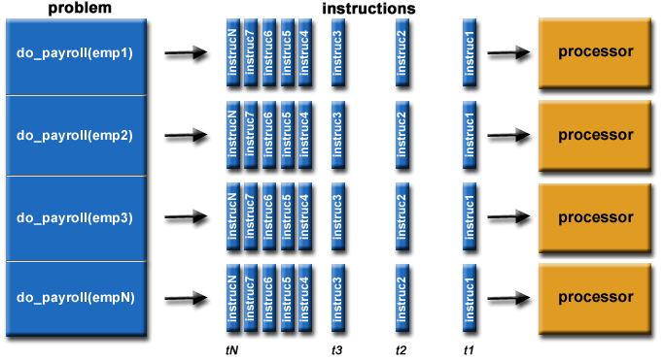

Slide 7
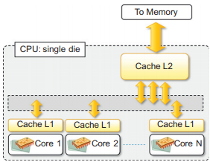
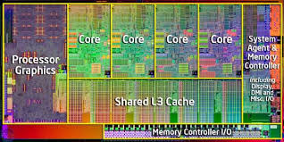
Multicore Technology

Slide 8
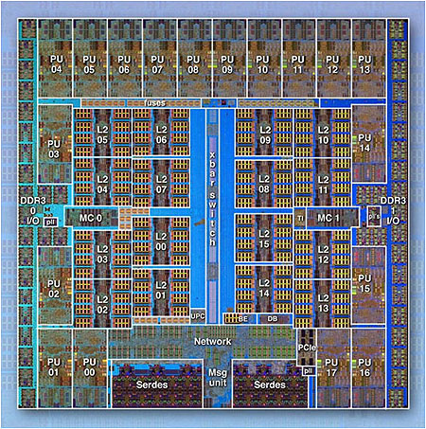
IBM BG/Q Compute chip with 18 cores and
16 L2 Caches

Slide 9
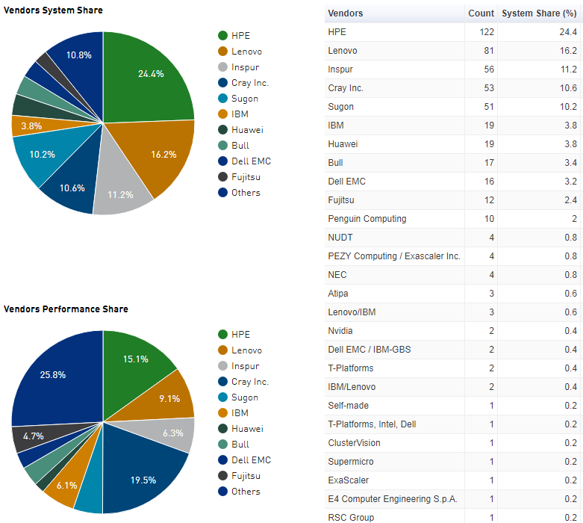
The majority of the world's large parallel computers (supercomputers) are clusters of hardware produced by a handful of (mostly) well known vendors.

Slide 10
This date is generally considered the end of the frequency-scaling era and the beginning of multicore technology.
Multicore technology has been used not only as a support for processor design but also in other devices, such as GPUs and network devices, thus becoming a standard practice for improving performance.
Multicore systems are composed of a single processor that features multiple processing cores that share the memory.
Each core has generally its own L1 cache, and the L2 cache is common to all the cores, which connect to it by means of a shared bus.
URL: https://computing.llnl.gov/tutorials/parallel_comp/

Slide 11
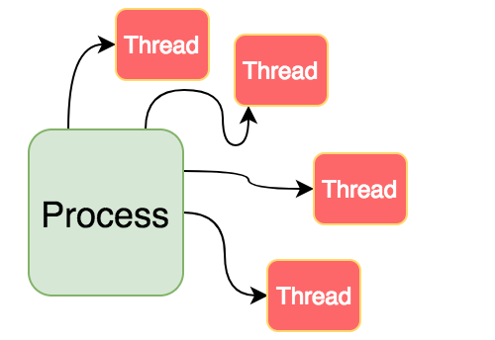
Nowadays, almost all the commonly used operating systems support multitasking and multithreading.
All the mainstream programming languages incorporate the abstractions of process and thread within their APIs.

Slide 12
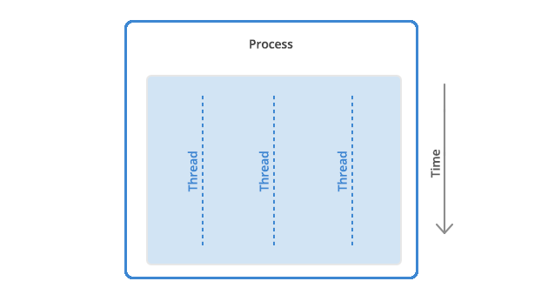
Programming applications with threads

Slide 13
Modern applications perform multiple operations at the same time.
Developers organize programs in terms of threads in order to express intraprocess concurrency
The use of threads might be implicit or explicit
Explicit: Decomposing your task and coordinate between them.
Implicit: Machine will do everything instead of Programmer.
What is a Thread?
A thread identifies a single control flow, which is a logical sequence of instructions, within a process.
Operating systems that support multithreading identify threads as the minimal building blocks for expressing running code.

Slide 14
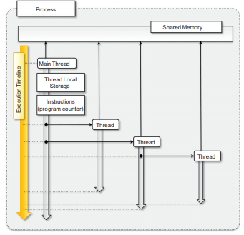
In a multitasking environment the operating system assigns different time slices to each process and interleaves their execution.
The process of temporarily stopping the execution of one process, saving all the information in the registers and replacing it with the information related to another process is known as a context switch.
The use of multiple threads in place of multiple processes is justified if and only if the tasks implemented are logically related to each other and require sharing memory or other resources.

Slide 15
Thread APIs
The support for multithreading comes according to the operating system and the specific programming languages that are used to develop applications.
It is possible to identify a minimum set of features that are commonly available across all the implementations.
POSIX Threads
Threading support in java and .NET

Slide 16
POSIX
Portable Operating System Interface for Unix (POSIX) is a set of standards related to the application programming interfaces for a portable development of applications over the Unix operating system flavors.
An implementation of the same specification has been provided for Windows-based systems.
POSIX standard defines the following operations:
Creation of threads with attributes,
Termination of a thread, and
Waiting for thread completion (join operation)

Slide 17
Points to remember from a programming point of view are:
A thread identifies a logical sequence of instructions.
A thread is mapped to a function that contains the sequence of instructions to execute.
A thread can be created, terminated, or joined.
A thread has a state that determines its current condition, whether it is executing, stopped, terminated, waiting for I/O, etc.
The sequence of states that the thread undergoes is partly determined by the operating system scheduler and partly by the application developers.
Threads share the memory of the process, and since they are executed concurrently, they need synchronization structures.
Different synchronization abstractions are provided to solve different synchronization problems

Slide 18
Threading support in java and .NET
Languages such as Java and C# provide a rich set of functionalities for multithreaded programming by using an object-oriented approach.
Java and .NET execute code on top of a virtual machine, the APIs exposed by the libraries refer to managed or logical threads.
These are mapped to physical threads by the runtime environment in which programs developed with these languages execute.
Both Java and .NET express the thread abstraction with the class Thread exposing the common operations performed on threads: Start, Stop, Suspend, Resume, Abort, Sleep, Join, and Interrupt.
The two frameworks provide different support for implementing synchronization among threads.

Slide 19
In the case of Java, most of them are contained in the java.util.concurrent package, whereas the rich set of APIs for concurrent programming in .NET is further extended by the .NET Parallel Extension framework.
Techniques for Parallel Computation with Threads:
Developing parallel applications requires an understanding of the problem and its logical structure.
Decomposition is a useful technique that aids in understanding whether a problem is divided into components (or tasks) that can be executed concurrently.

Slide 20
The two main decomposition/partitioning techniques are domain and functional decompositions.
Domain | Functional
Functionally repetitive, but independent, computation on data Repetitive calculations required for solving a problem. | Functionally distinct but independent computations
Very common | Less common
Calculations are identical, only differ from the data they operate on, and can be executed in any order, the problem is said to be embarrassingly parallel | Type of computation rather than on the data manipulated by the computation.
The master-slave model is a quite common organization for these scenarios

Slide 21
Domain Decomposition
The system is divided into two major code segments.
One code segment contains the decomposition and coordination logic.
Another code segment contains the repetitive computation to perform.
A master thread executes the first code segment.
As a result of the master thread execution, as many slave threads as needed are created to execute the repetitive computation.
The collection of the results from each of the slave threads and an eventual composition of the final result are performed by the master thread.
NOTE: In general, a while or a for loop is used to express the decomposition logic, and each iteration generates a new unit of work to be assigned to a slave thread.

Slide 22
Units of work
Process
Result
a. Embarrassingly parallel
Units of work
Process
Result
b. Inherently sequential

Slide 23
Several practical problems fall into Domain category:
Geometrical transformation of two (or higher) dimensional data sets.
Independent and repetitive computations over a domain such as Mandelbrot set and Monte Carlo computations.
Based on the strong assumption that at each of the iterations of the decomposition method, it is possible to isolate an independent unit of work.
This is what makes it possible to obtain a high computing throughput.
Such a condition is not met if the values of all the iterations are dependent on some of the values obtained in the previous iterations- inherently sequential.
EX: Matrix multiplication using multiple threads.

Slide 24
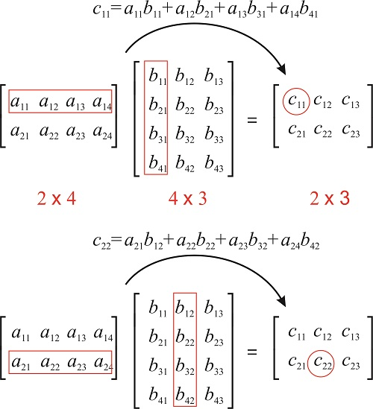
Matrix multiplication is a binary operation that takes two matrices and produces another matrix as a result.
There are several techniques for performing matrix multiplication; among them, the matrix product is the most popular.
The resulting matrix will have the number of rows of the first matrix and the number of columns of the second matrix.
It is evident that the repetitive operation is the computation of each of the elements of the resulting matrix.

Slide 25
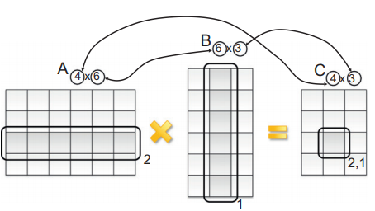
The computation does not depend on values that have been obtained by the computation of other elements of the resulting matrix Embarrassingly parallel, and we can logically organize the multithreaded program in the following steps:
Define a function that performs the computation of the single element of the resulting matrix by implementing the previous equation.
Create a double for loop (the first index iterates over the rows of the first matrix and the second over the columns of the second matrix) that spawns a thread to compute the elements of the resulting matrix.
Join all the threads for completion, and compose the resulting matrix.

Slide 26
Functional decomposition
Natural decomposition of the problem in separate units of work because it does not involve partitioning the dataset, but the separation among them is clearly defined by distinct logic operations.
Units of work
Process
Unit 1
Unit 2
Result
Unit 3
Unit 4
Unit 5

Slide 27
Problems that are subject to functional decomposition can also require a composition phase in which the outcomes of each of the independent units of work are composed together.
EX: Calculate the value of the following function for a given value of x:
F(x)= sin(x)+ cos(x)+tan(x)

Slide 28
Computation vs. communication
The two decomposition methods and the corresponding sample applications are based on the assumption that the computations are independent.
The input values required by one computation do not depend on the output values generated by another computation.
The different units of work generated as a result of the decomposition do not need to interact (i.e., exchange data) with each other.
Above two allow achieving a high degree of parallelism and a high throughput

Slide 29
The need to exchange data among different threads introduces dependencies among them and ultimately can result in introducing performance bottlenecks.
A more common disadvantage is the fact that while a thread exchanges data with another one, it uses some kind of synchronization strategy that might lead to blocking the execution of other threads.
As a general rule of thumb, it is important to minimize the amount of data that needs to be exchanged while implementing parallel and distributed applications to achieve highest throughput.

Slide 30
Multithreading with Aneka
As applications become increasingly complex, there is greater demand for computational power that can be delivered by a single multicore machine.
Different units of work are not executing within the same process space but on different nodes, both the code and the data need to be moved to a different execution context.
The amount of effort required to convert an application often depends on the facilities offered by the middleware managing the distributed infrastructure.
In reality, these “threads” are independent processes executing on different nodes and do not share memory or other resources, but they allow you to write applications using the same thread constructs for concurrency and synchronization as with traditional threads.

Slide 31
Introducing the Thread Programming Model
Aneka offers the capability of implementing multithreaded applications over the cloud by means of the Thread Programming Model.
This model introduces the abstraction of distributed thread, also called Aneka thread, which mimics the behaviour of local threads but executes over a distributed infrastructure.
In the case of the Thread Programming Model, the application is designed as a collection of threads, the collective execution of which represents the application run.
Threads are created and controlled by the application developer, while Aneka is in charge of scheduling their execution once they have been started.
Threads are transparently moved and remotely executed while developers control them from local objects that act like proxies of the remote threads.

Slide 32
Developers do not have to completely rewrite applications in order to leverage Aneka.
The process of porting local multithreaded applications is as simple as replacing the System.Threading.Thread class and introducing the AnekaApplication class.
There are three major elements :
Application :This class represents the interface to the Aneka middleware and constitutes a local view of a distributed application.
Threads: Threads represent the main abstractions of the model and constitute the building blocks of the distributed application.
Thread Manager: This is an internal component that is used to keep track of the execution of distributed threads and provide feedback to the application

Slide 33
Porting local multithreaded applications to Aneka involves defining an instance of the AnekaApplication , AnekaThread, ThreadManager . class and replacing any occurrence of System.Threading.Thread with Aneka.Threading.AnekaThread.
Aneka applications expose additional other properties, such as events that notify the completion of threads, their failure, the completion of the entire application, and thread state transitions.
Aneka Thread vs. Common Threads
Interface compatibility
Thread life cycle
Thread synchronization
Thread priorities
Type serialization

Slide 34
Interface compatibility
The Aneka.Threading.AnekaThread class exposes almost the same interface as the System.Threading. Thread class with the exception of a few operations that are not supported.
Operations that involve the temporary interruption of the thread execution have not been supported.
First the use of the Suspend/Resume operations is generally a deprecated practice, even for local threads, since Suspend abruptly interrupts the execution state of the thread.
Second, thread suspension in a distributed environment leads to an ineffective use of the infrastructure,
This is also the reason that the Sleep operation is not supported. Therefore, there is no need to support the Interrupt operation, which forcibly resumes the thread from a waiting or a sleeping state.
To support synchronization among threads, a corresponding implementation of the Join operation has been provided.

Slide 35
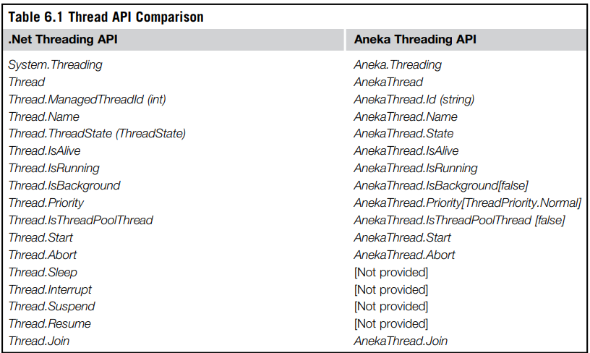

Slide 36
Thread life cycle
Aneka threads live and execute in a distributed environment, their life cycle is necessarily different from the life cycle of local threads.
The white balloons =indicate states that do not have a corresponding mapping on the other life cycle;
The shaded balloons =common states.
In most cases, the normal state transition will resemble the one occurring for local threads:
Unstarted-[Started]-[Queued]-Running-Completed/Aborted/Failed.

Slide 37
Unstarted
Unstarted
Start()
Start()
StagingIn
Started
Rejected
Running
Abort()
Abort
Requested
Suspend
Requested
Suspend()
Normal Completion
Queued
Aborted
Resume ()
Suspended
Wait
SleepJoin
Stopped
Running
Failed
Wait()/Sleep()/Join()
Interrupt()
Staging
Out
Completed
a. System.Threading.Thread life cycle.
b. Aneka.Threading.AnekaThread life cycle.

Slide 38
Thread synchronization
The .NET base class libraries provide advanced facilities to support thread synchronization by the means of monitors, semaphores, reader-writer locks, and basic synchronization constructs at the language level.
Aneka provides minimal support for thread synchronization that is limited to the implementation of the join operation for thread abstraction.
No shared memory among the thread instances and therefore it is not necessary.
Providing coordination facilities that introduce a locking strategy in such an environment might lead to distributed deadlocks that are hard to detect.

Slide 39
Thread priorities
System.Threading.Thread class supports thread priorities :
Highest, Above Normal, Normal, Below Normal, or Lowest.
Aneka does not support thread priorities.
For interface compatibility purposes the Aneka.Threading.Thread class exhibits a Priority property whose type is ThreadPriority, but its value is always set to Normal

Slide 40
Type serialization
Local threads execute all within the same address space and share memory; therefore, they do not need objects to be copied or transferred into a different address space.
The state of the enclosing instance needs to be transferred and reconstructed on the remote execution environment
Aneka threads execute methods defined in serializable types, since it is necessary to move the enclosing instance to remote execution method.
Providing serialization is as easy as tagging the class definition with the Serializable attribute.

Slide 41
Programming applications with Aneka threads
Aneka threads application model:
To develop distributed applications with Aneka threads, it is necessary to specialize the template type as follows:
AnekaApplication <AnekaThread, ThreadManager >
Another important component of the application model is the Configuration class, which is defined in the Aneka.Entity namespace (Aneka.dll).

Slide 42
This class contains a set of properties that allow the application class to configure its interaction with the middleware, such as
The address of the Aneka index service, which constitutes the main entry point of Aneka clouds;
The user credentials required to authenticate the application with the middleware;
Some additional tuning parameters;
And an extended set of properties that might be used to convey additional information to the middleware
Domain decomposition: matrix multiplication- 6.4.2
Functional decomposition: Sine, Cosine, and Tangent-6.4.3
Page Numbers=197

Slide 43
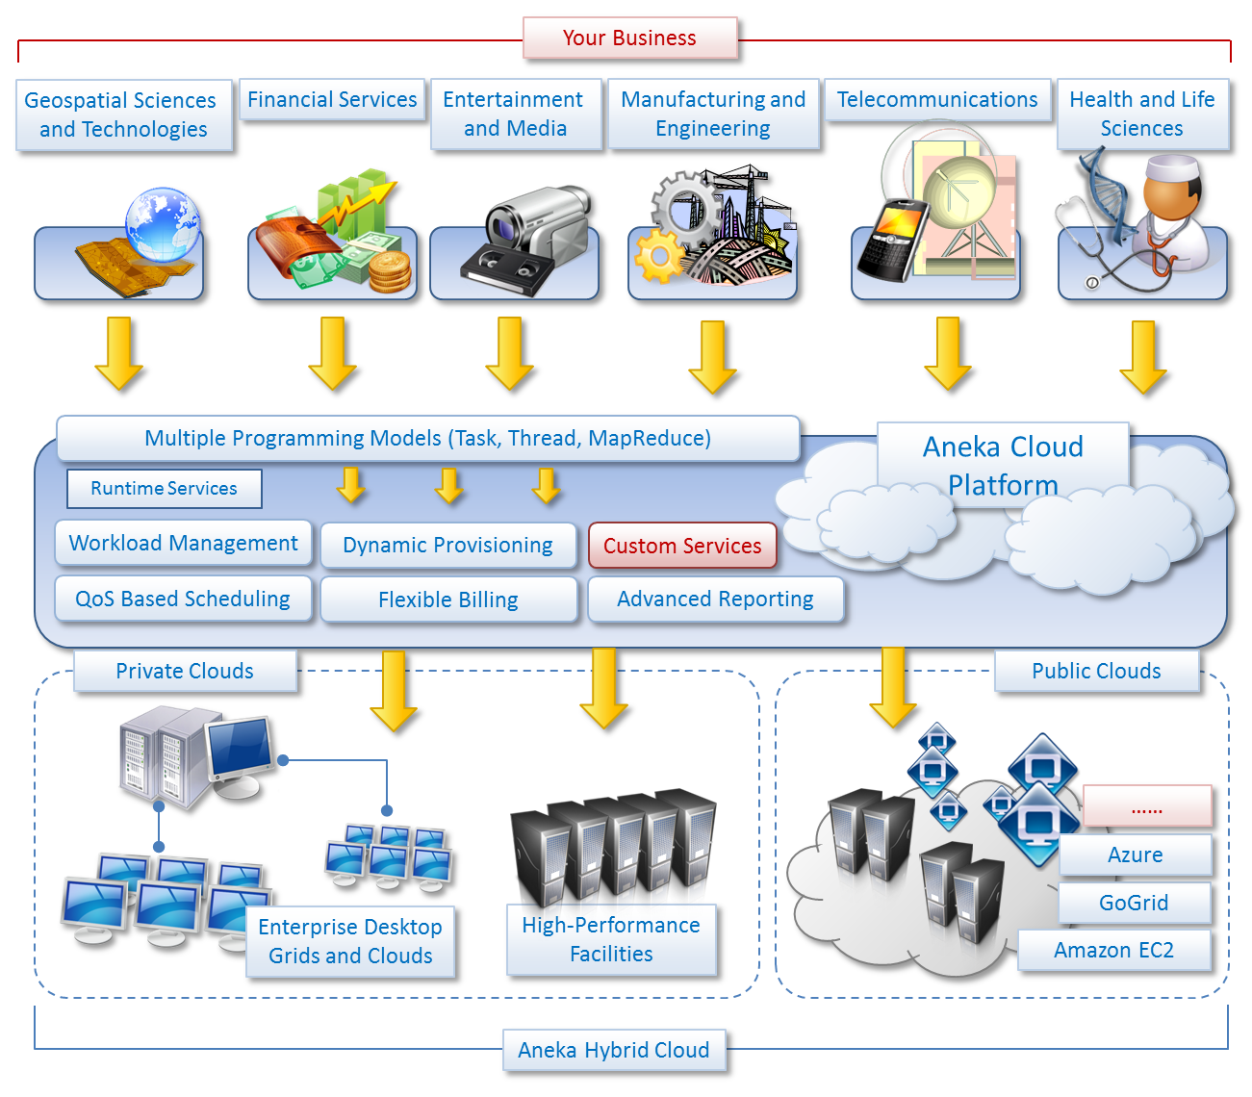

Slide 44
Questions-I
Throughput Computing?
Difference between Multiprocessing, multiprogramming, multitasking, multithreading
Difference between Asymmetric and Symmetric multiprocessing with examples
Parallelisation Technique with example
Multicore Technology through diagram
Process Vs Thread - Real time Examples
Implicit Vs Explicit Thread
POSIX?
Logical Thread VS Physical Thread
Techniques for parallel computation
Domain Vs Functional Decomposition
How Matric Multiplication using threads is related to Domain Decomposition
Embarrassingly Parallel Vs Inherently Sequential
Functional Decomposition with examples.

